Slide 1

Tunnels to Towers Foundation –
Homeless Veteran Program

Slide 2

Welcome & Purpose
Welcome and Thank you for meeting
Explore partnership & expand veteran impact
Notes:
The goal today is to learn more about each other’s work and explore partnership opportunities that expand impact for the Detroit community,
especially veterans who may benefit from housing and supportive services.

Slide 3
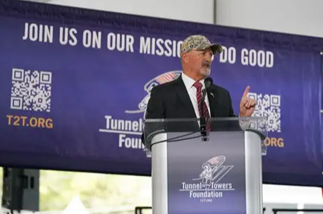
Who We Are
Founded in honor of FDNY Firefighter Stephen Siller (9/11)
Mission: service, dignity, long-term support
National footprint, multiple programs
Notes:
Tunnels to Towers was Founded in honor of FDNY Firefighter Stephen Siller, who gave his life on 9/11. The Siller Family started the foundation with first responders in mind and later expanded it to serve veterans as well.
The Foundation is rooted in service, dignity, and long-term support for first responders and veterans.
Expanded nationally with multiple programs, including housing and supportive services.

Slide 4
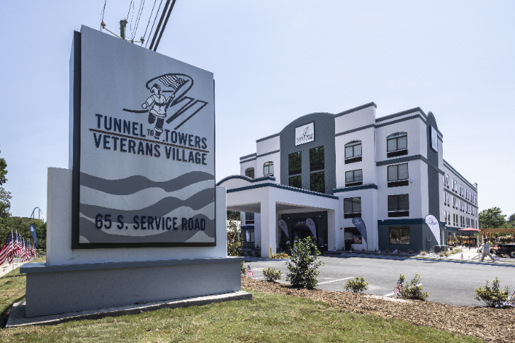
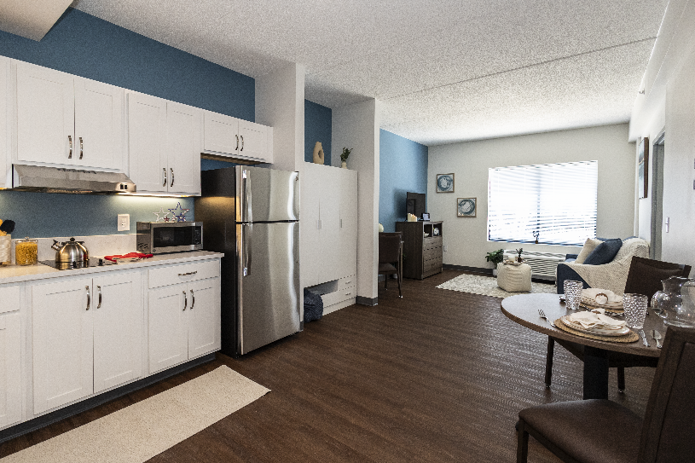

Homeless Veteran Program (HVP)
Mission: end veteran homelessness nationwide
Villages are currently in Houston & Atlanta:
New locations opening soon in multiple states: Harrisburg PA, Denver Colorado, Memphis Tennessee, and Southfield/Detroit, Michigan in 2026.
Partnerships critical for success- Mission aligned
Notes:
Our Homeless Veteran Program develops supportive housing villages combining safe housing with comprehensive on-site services.
We connect with mission-aligned organizations to enhance services and strengthen our veteran outcomes.
Many veterans have disabilities or employment barriers, where partners like (name organization) can bring expertise and opportunity.
Our upcoming village in Southfield is scheduled to open by the end of Q3. We’re connecting with local partners now to ensure strong service coordination from day one.

Slide 5
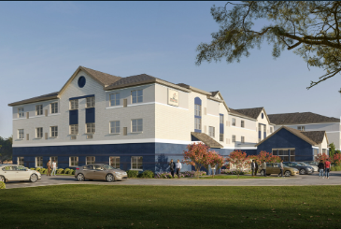
Detroit Village- Supportive Housing
Daily operations & on-site services
Intake, retention, caseload oversight
Staff supervision & community collaboration
Notes:
Our village oversees daily operations and ensures veterans receive all on-site supportive services.
We focus on intake, engagement, housing retention, staff supervision, and collaboration with partners.

Slide 6
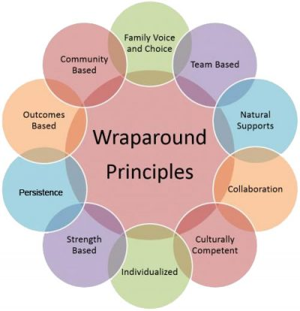
Wraparound Services
Case Managers
Licensed Clinician
Entitlement Coordinator
Employment Coordinator
Veteran Support Advocates
Focus: stability, wellness, reintegration
Notes:
All veterans in our villages receive comprehensive support.
The goal is long-term stability, wellness, and community reintegration, not just housing placement

Slide 7
Partnership Exploration
Learn partner priorities & veteran engagement
Explore referral, coordinated services, employment/community support
Shared outcomes
Notes:
Through outreach, we aim to understand local services, veteran engagement, and opportunities for complementary service delivery.
We’d love to hear more about (NAME THE ORGANIZATION THAT YOU ARE MEETING) : your mission, your work in the community, and what you see as priorities in this region.

Slide 8
NEXT STEPS?
We aim to ensure veterans have stable housing and the supports needed to thrive.
Notes:
Reiterate shared goal: “We aim to ensure veterans have stable housing and the supports needed to thrive.”
Next steps: follow-up conversations, program-level alignment, referral coordination, site visits, or planning discussions.

